Slide 1
JAIC’s session: Scholarly writing for conservation
AIC 2020 Virtual Meeting
Date: Tuesday, June 23, 2020
Time 11:00-12:30 (EST)

Slide 2

Julio M. del Hoyo-Meléndez
National Museum in Krakow
JAIC, Editor-in-Chief (2014-present)

Slide 3
Outline
1. Julio M. del Hoyo-Meléndez, “Overview of JAIC”
2. Suzanne Davis, AIC's Vice President and Corina Rogge, JAIC Associate Editor
“The ethics of authorship, acknowledgements, and credit”
3. Catherine Stephens, JAIC Associate Editor, “Writing Style”
4. Robin Hanson, JAIC Associate Editor, “The Mechanics of Writing for JAIC”
5. George Cooper, Managing Editor, Journals Anthropology, Conservation, Museum Studies & Heritage at Taylor & Francis “How to publish an article with impact”
6. Heidi Lowther, Commissioning Editor for conservation books at Routledge
“Tips on How to publish your first book”
7. Discussion Q&A
Notes:
Today’s session will consist of the following presentations along with a discussion and Q&A at the end of the presentations.

Slide 4
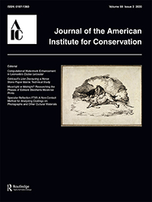
Publication history
Currently known as:
Journal of the American Institute for Conservation (1977 - current)
Formerly known as:
Bulletin of the American Institute for Conservation (1974 - 1976)
International Institute for Conservation of Historic and Artistic Works: Bulletin of the American Group (1960 - 1973)
Notes:
Here is a brief history of our publication showing the different names of journal over the past 60 years.

Slide 5
Aims and Scope
JAIC is the primary vehicle of AIC for the publication of peer-reviewed technical studies, research papers, treatment case studies, and ethics and standards discussions relating to the broad field of conservation and preservation of historic and cultural works. JAIC welcomes short communications and longer submissions on subjects of interest to preservation and conservation professionals. Manuscripts are reviewed for their interest and overall suitability for the Journal, as well as for accuracy, clarity, and uniqueness.
The journal welcomes submissions especially in the following areas: Architecture, Archaeology, Books and Paper, Collections Care, Electronic media, Paintings, Photography, Preventive Conservation, Objects, Research and Technical studies, Textiles, and Wooden Artifacts, among others.
Notes:
JAIC is the primary vehicle of AIC…
We welcome short communications and longer submissions…
The main areas are shown at the bottom of the slide, and they are essentially the different specialty groups of AIC.

Slide 6
Why publish ?
Dissemination
Extend knowledge
Organize and describe
Responsibility
Support to your institution
Essential for building your career
Marie Christodulaki, Marie and Robyn Sloggett. 2016. Reporting on a survey of peer-reviewed publishing in cultural materials conservation: perceptions, preferences, and decision making. Studies in Conservation,
DOI: 10.1080/00393630.2016.1151098
Notes:
Here is an important question. Why publish?
We want to publicate because we want to disseminate our knowledge. We want to organize, describe and share our results with our colleagues. It is our responsibility. We want also to support our institution and publication is essential for building your career.

Slide 7
Literature
Thorough review
Novel topic – new knowledge
Narrow your search down to your topic
References important at planning and final stages
Summary of state of the art Introduction
Notes:
One of the first steps of publishing is to look at the literature. We want to conduct a thorough review of the literature, make sure our topic is novel, we are contributing new knowledge to the field. We want to narrow our search down to our specific topic. We know that references are quite important at planning and final stages. At the end, we will end up with a summary of the state of the art, which will become our Introduction.

Slide 8
Preparing your paper
Structure
Content - outline first and then fill gaps
Identify knowledge gap
Specify why the topic is new
Message - one per paper
Notes:
Here are some things to consider when preparing your paper. First, you want to look at the structure of your paper, you want to make sure you follow the writing guidelines for JAIC. You want to look at the content of your paper. Generally, you should make an outline first and then start filling the gaps. Make sure you identify the knowledge gap and specify why the topic is new and interesting for readers. You want to convey one message per paper.

Slide 9
Checklist before submission
Author details
Abstract (200 words)
Graphical abstract (optional) *
8 keywords
Funding details
Short biographical note for each author (~ 100 words)
Geolocation information
High quality figures
Tables
Units
Spelling and Grammar
Notes:
The checklist before submission. First make sure to include your details as an author. You need to include an abstract of up to 200 words. Keywords are also very important, you have a maximum of 8. Information about funding, a short biographical note for each author of around 100 words. Make sure to submit high quality figures, tables, and last but not least spelling and grammar. Make sure you send your paper for revision, proofreading to some of your colleagues before you submit.

Slide 10
What is the process?
Author submits manuscript electronically,
Editor assigns paper to an Associate Editor,
3. AE selects reviewers, usually two and sometimes three,
4. Within a few months, the Author receives the combined
comments of the reviewers, the AE, and the Editor,
5. The Author revises the manuscript and addresses the queries,
6. The revised manuscript is reviewed by the AE and Editor.
Notes:
Here is an overview of the publication process. The first step is submitting your paper electronically. I will then assign your paper to an associate editor based on the different areas of expertise that we cover and the topic of your paper. The associate editor will then select reviewers, there’s usually two and sometimes even three reviewers per paper. Within a few months you will receive the combined comments of the reviewers, the associate editor and myself. You are required then to revise your manuscript and address all the issues raised by the reviewers. Once you’re ready you can send your revised manuscript, which will be reviewed by the associate and myself. Based on your comments and answers, we will make a decision on your paper.

Slide 11
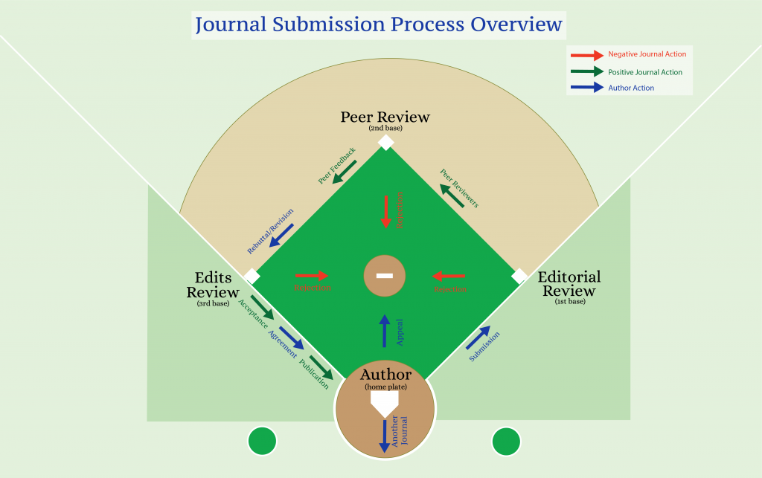
Source: https://wordvice.com/journal-submission-rebuttal-letter/
Notes:
I like to use the analogy of a baseball game. Here is an interpretation of the publication process. You as an author are at the batting position. I am waiting for you with the associate editor in first base and we will determine whether or not you will go to second base. If we decide that your paper meets the quality standards of the journal, you will go to second base. At second base the reviewers are waiting for you. They will read your paper, make some comments. You are expected to address the different issues raised by the reviewers and this will advance you to third base. Once you get to third base, your acceptance or rejection will depend on how well you addressed all the issues raised by the reviewers and how good is the revised version of the paper. If your paper is accepted, then you win, you have score a run.

Slide 12
Peer review
Mechanism used to ensure that shared knowledge can
be tested and evaluated in a rigorous and verifiable way
Comments from editors and reviewers, not to be taken personally
Remain respectful (author ↔ reviewer)
Include a point by point response to comments
Feedback helps to improve papers significantly
Notes:
Peer review is used to ensure that share knowledge can be evaluated in a rigorous way.
We want the comments from editors and reviewers to authors to be constructive comments, they’re not meant to be taken personally. We also want that the communication between authors and reviewers remains respectful. It is important to include a point by point response to the comments made by the reviewers. This feedback helps to greatly improve the papers.

Slide 13
Scopus is the largest abstract and citation database
of peer-reviewed literature: scientific journals, books and conference proceedings.
Covers nearly 36,377 titles from approximately 11,678 publishers, of which 34,346 are peer-reviewed journals in top-level subject fields Life Sciences, Social Sciences, Physical Sciences and Health Sciences
Gives four types of quality measure for each title; those are H-Index, CiteScore, SJR (SCImago Journal Rank) and SNIP (Source Normalized Impact per Paper)
Notes:
I want to take some time to talk about Scopus, which is the largest abstract and citation database of peer-reviewed literature and it covers approximately 35,000 peer-reviewed journals including JAIC. We are very happy that we are indexed in Scopus. They offer different types of quality measures for the journal. One that interests us is CiteScore.

Slide 14
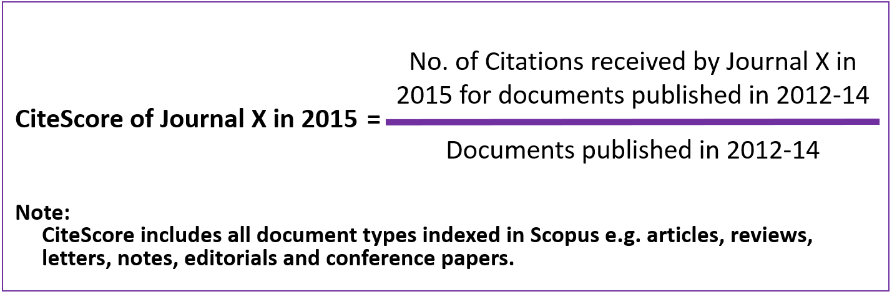
CiteScore
Calculation is based on Scopus data,
Uses a 3-year window,
Includes all document types indexed by Scopus, include articles, reviews, letters, notes, editorials, conference papers, etc.
Van Noorden, R., Controversial impact factor gets a heavyweight rival, Nature, 540, 325–326.
(15 December 2016) doi:10.1038/nature.2016.21131
Notes:
CiteScore is a metric based on Scopus data. It uses a 3-year window and it includes all documents types indexed by Scopus. Here is an example showing you the CiteScore of a journal in 2015. We are basically looking at the number of citations received by the journal in 2015 for documents published in the three previous years, divided by the numer documents published in those three years.

Slide 15
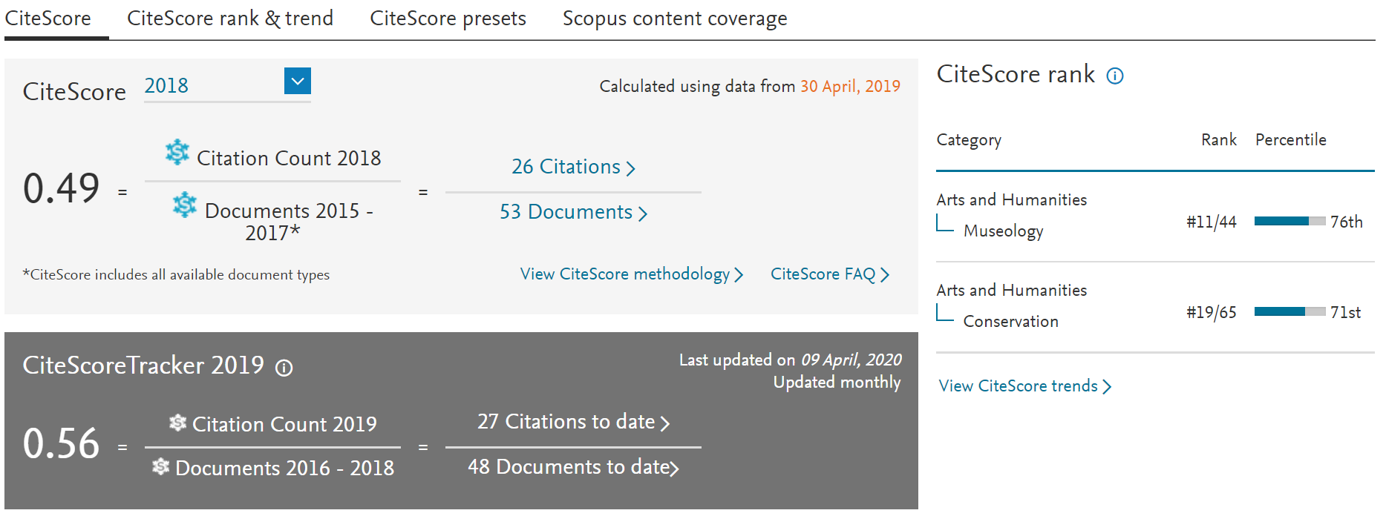
https://www.scopus.com
Notes:
Here are some CiteScores for JAIC for 2018. The calculation gave 0.49. After comparing to 2019 (darker gray rectangle), the CiteScore is 0.56 showing a slight increase. They also ranked the journal. For example, if you look at arts and humanities - conservation, you can see that JAIC is ranked 19 out of 65 journals in that particular area.

Slide 16
JAIC Associate Editors
Name | Areas of expertise
Gregory Bailey | Objects conservation: decorative arts, enamel, glass, ceramics, and functional objects.
Brenna Campbell | Book and paper, special collections, preventive conservation.
Mary Coughlin | Collection care and conservation of contemporary museum collections
Lee Ann Daffner | Photographic materials conservation
Joshua Freedland | Architectural conservation, built heritage, monuments conservation, historic preservation
Susanne Gänsicke | Objects conservation, ancient and historic metalwork.
Robin Hanson | Textile conservation
Arlen Heginbotham | Wooden artifacts and technical studies of museum objects
Paul Himmelstein | Paintings conservation
Julie Lauffenburger | Objects conservation, archaeology, anthropology
Ellen Pearlstein | Conservation of ethnographic objects
Julie A Reilly | Objects conservation, preventive conservation
Corina Rogge | Conservation science
Gregory Dale Smith | Art technological research, conservation science
Catherine H Stephens | Conservation science, degradation of paper
https://www.tandfonline.com/action/journalInformation?show=editorialBoard&journalCode=yjac20
Notes:
Here is a list of our associate editors along with their areas of expertise. I also encourage you to visit the link below and look for their email addresses. Feel free to contact them if you have any questions or problems. You may contact an AE if you have an idea about a paper that you want to write, or any material that you would like to discuss before you submit. You are more than welcome to write to them.

Slide 17
JAIC Editorial Team
Bonnie Naugle
JAIC Managing Editor
Carmina Lamare-Bertrand
AIC Communications Associate
Translation Editors:
Beatriz Haspo
Library of Congress, USA
Esther Méthé
Private Practice, Canada
Amparo Rueda
APOYOnline, Colombia
Book Review Editor:
Cybele Tom
Art Institute of Chicago, USA
Taylor and Francis:
George Cooper – Managing Editor, Journals Anthropology, Conservation, Museum Studies & Heritage
Notes:
Here is the JAIC editorial team. We have Bonnie Naugle our Managing Editor, who works along with Carmina Lamare Bertrand, AIC Communications Associate. Then we have the translation editors. Beatriz Haspo for Portuguese, Esther Méthé - French, and Amparo Rueda - Spanish. Cybele Tom is our book review editor and we also collaborate with George Cooper from Taylor and Francis. Thank you very much for your attention and we will continue now with the remaining presentations.

Slide 18
JAIC’s session: Scholarly writing for conservation
AIC 2020 Virtual Meeting
Date: Tuesday, June 23, 2020
Time 11:00-12:30 (EST)

